Slide 1

Use of Computer Technology for Insight and Proof
A. Eight Historical Examples
B. Weaknesses and Strengths
R. Wilson Barnard, Kent Pearce
Texas Tech University
Presentation: January 2010
Notes:
Illustrate via of papers out of the last ten years scenarios where inequalities arose and and illustrate the mechanisms which we used to analytically verify that the inequalities held.

Slide 2
Eight Historical Examples
π/4’s Conjecture
2/3’s Conjecture
Omitted Area Problem
Polynomials with Nonnegative Coefficients

Slide 3
Eight Historical Examples
π/4’s Conjecture
2/3’s Conjecture
Omitted Area Problem
Polynomials with Nonnegative Coefficients
Coefficient Conjecture of Brannan
Bounds for Schwarzian Derivatives for Hyperbolically Convex Functions
Iceberg-type Problems in Two-Dimensions
Campbell’s Subordination Conjecture

Slide 4


π/4’s Conjecture
Let D denote the open unit disk in the complex plane and let A be the set of analytical functions on D.
Let S denote the usual subset of A of normalized univalent functions.
Let L denote a continuous linear functional on A.
A support point of S (with respect to L) is a function such that

Slide 5
π/4’s Conjecture
In ’70s, one of the active approaches to attacking the Bieberbach Conjecture was routed through an investigation of extreme points and support points of S (since coefficient functionals are among other things linear).
Brickman, Brown, Duren, Hengartner, Kirwan, Leung, MacGregor, Pell, Pfluger, Ruscheweyh, Schaeffer, Schiffer, Schober, Spencer, Wilken

Slide 6
π/4’s Conjecture
Using boundary variational techniques, certain necessary conditions were deduced that a support point of S had to satisfy. Specifically, if Γ is the complement of the range of a support point of S, then
  Γ is a trajectory of a quadratic differential
  Γ is a single analytical arc tending to ∞
  Γ tends to ∞ with monotonically increasing modulus
  Γ is asymptotic to a half-line at ∞
  Γ satisfies the “π/4 property”

Slide 7
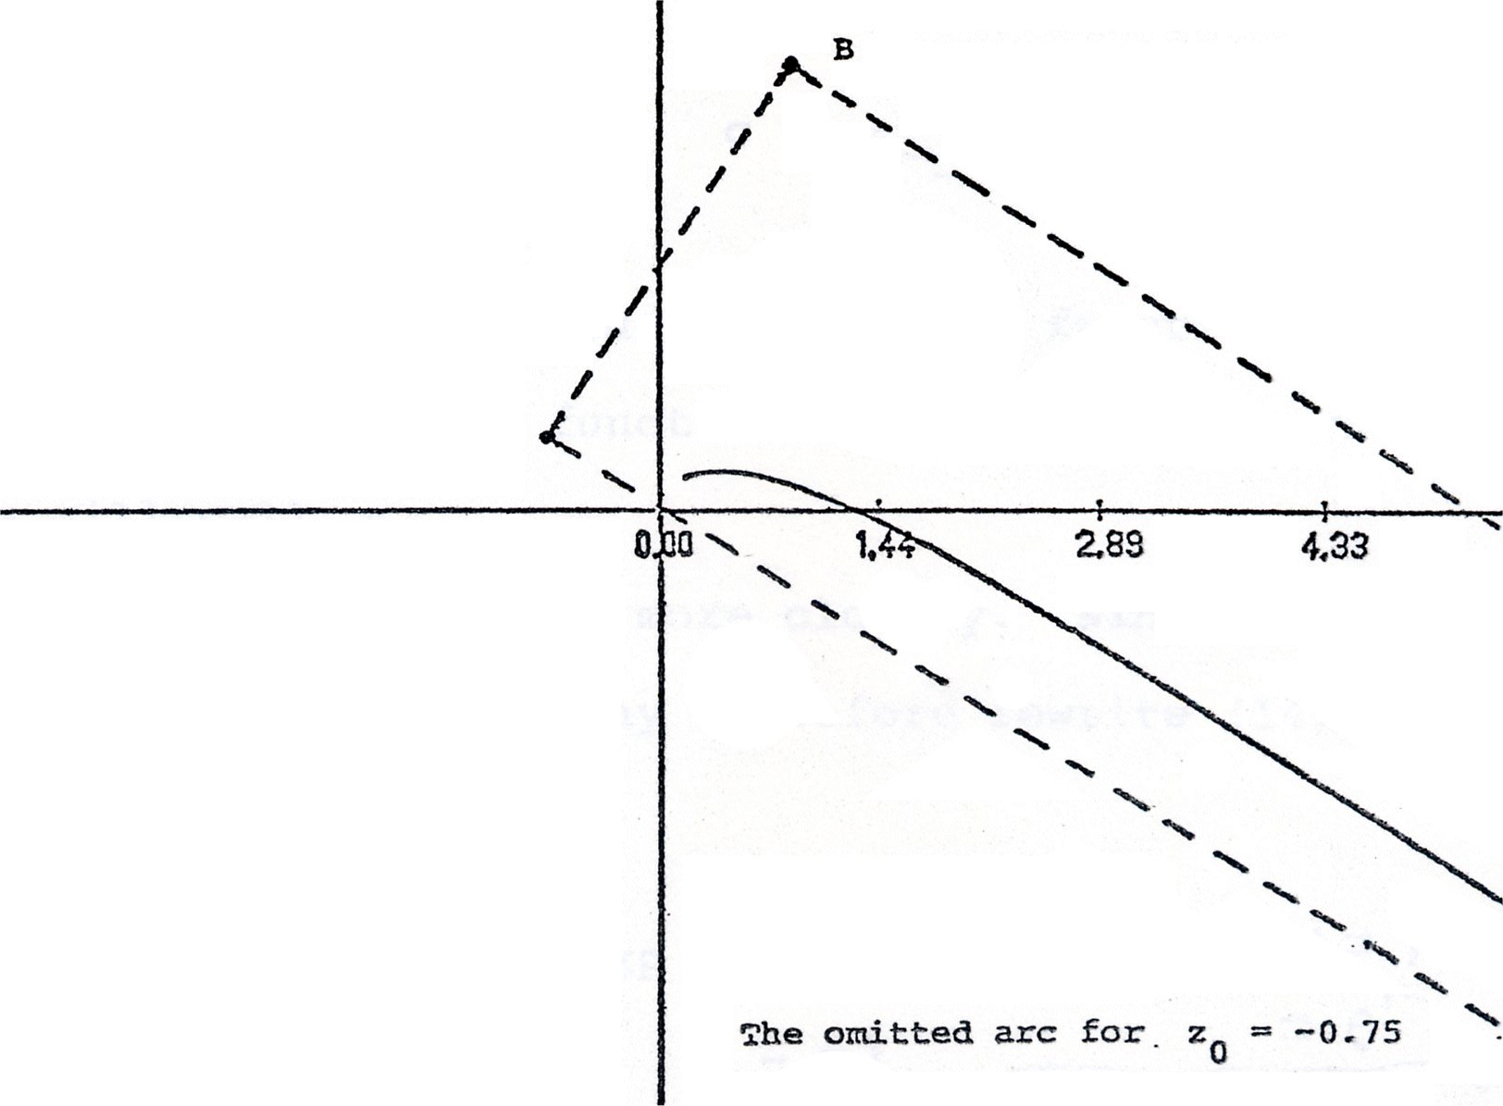
π/4’s Conjecture

Slide 8
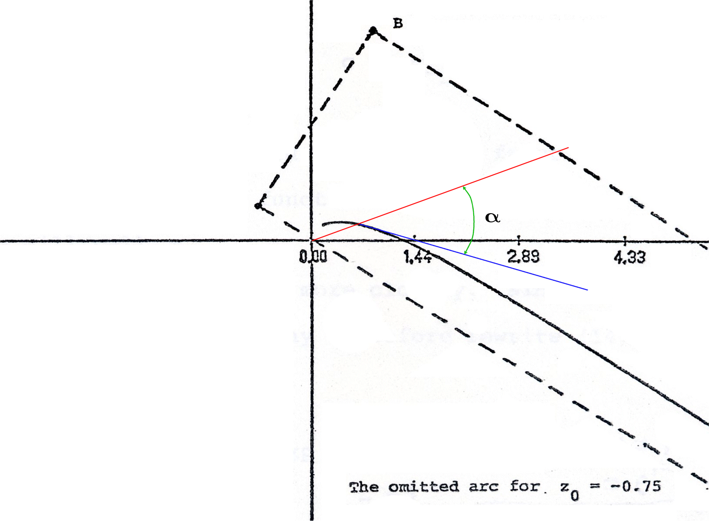
π/4’s Conjecture

Slide 9

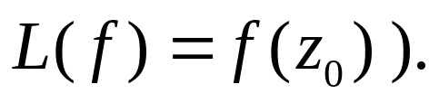
π/4’s Conjecture
At that time, the Koebe function was the only explictly known example of a support point (since it maximized the linear functional ).
Brown (1979)
Explicitly identified the support points for point evaluation functionals (functionals of the form

Slide 10

π/4’s Conjecture
He observed
“Numerical calculations indicate that the known bound π/4 for the angle between the radius and tangent vectors is actually best possible . . . for a certain point on the negative real axis, the angle at the tip of the arc approximates π/4 to five decimal places.”

Slide 11
π/4’s Conjecture
Shortly thereafter, I made an observation that a sharp result of Goluzin for bounding the argument of the derivative of a function in S could be interpreted to identify certain associated extremal functions (close-to-convex half-line mappings) as a support points of S and that π/4 was achieved exactly at the finite tip of the omitted half-line for two of these half-line mappings.
Notes:
Later Duren, Leung & Schiffer showed that π/4 cannot be achieved by a point evaluation functional

Slide 12
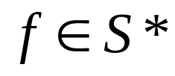
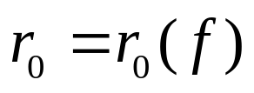
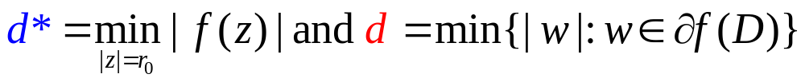
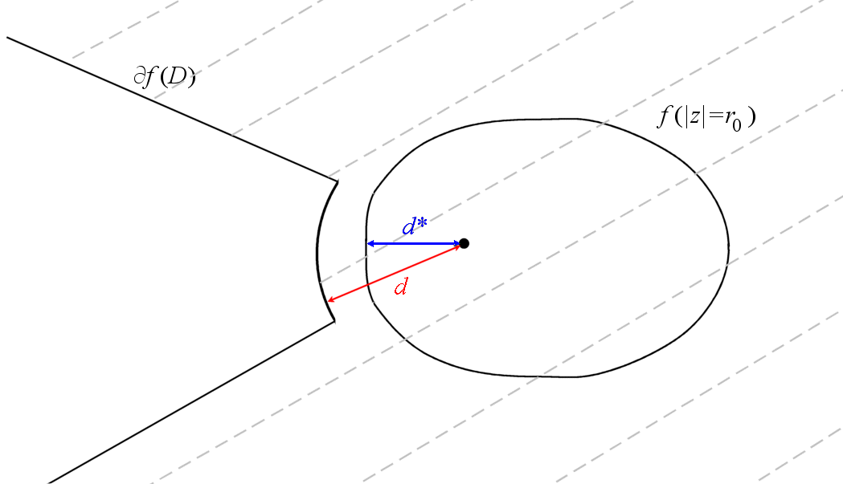
2/3’s Conjecture
Let S* denote the usual subset of S of starlike functions. For let denote the radius of convexity of f. Let

Slide 13
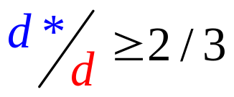
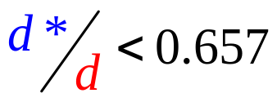
2/3’s Conjecture
A. Schild (1953) conjectured that
Barnard, Lewis (1973) gave examples of
a. two-slit starlike functions and
b. circularly symmetric starlike functions
for which
Footnote
Notes:
Concluding paragraph from reprint

Slide 14

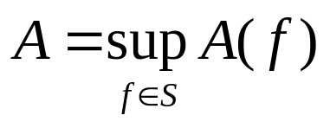
Omitted Area Problem
Goodman (1949)
For . Find
Goodman
  0.22π < A < 0.50π
Goodman, Reich (1955)
A < 0.38π
Barnard, Lewis (1975)
A < 0.31π

Slide 15
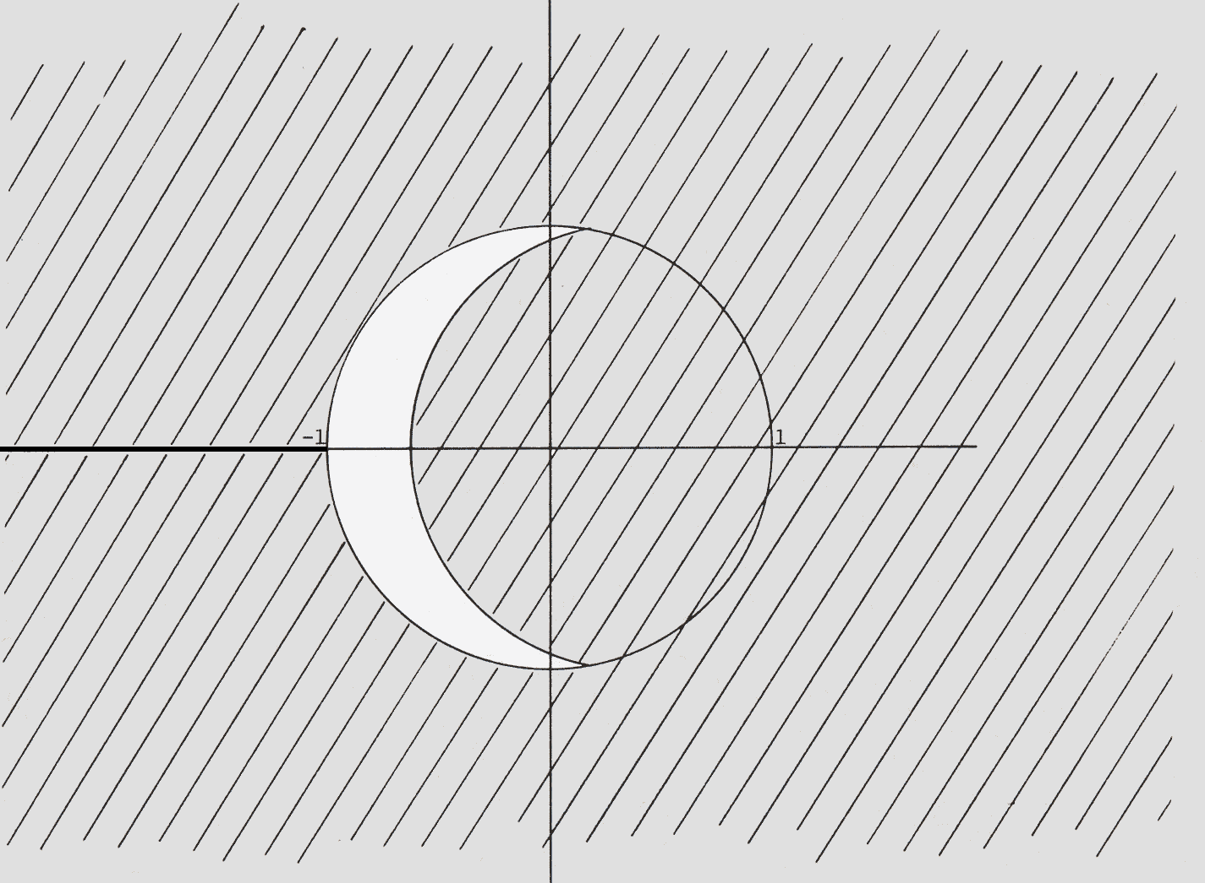
Omitted Area Problem
Lower Bound (Goodman 1949)

Slide 16
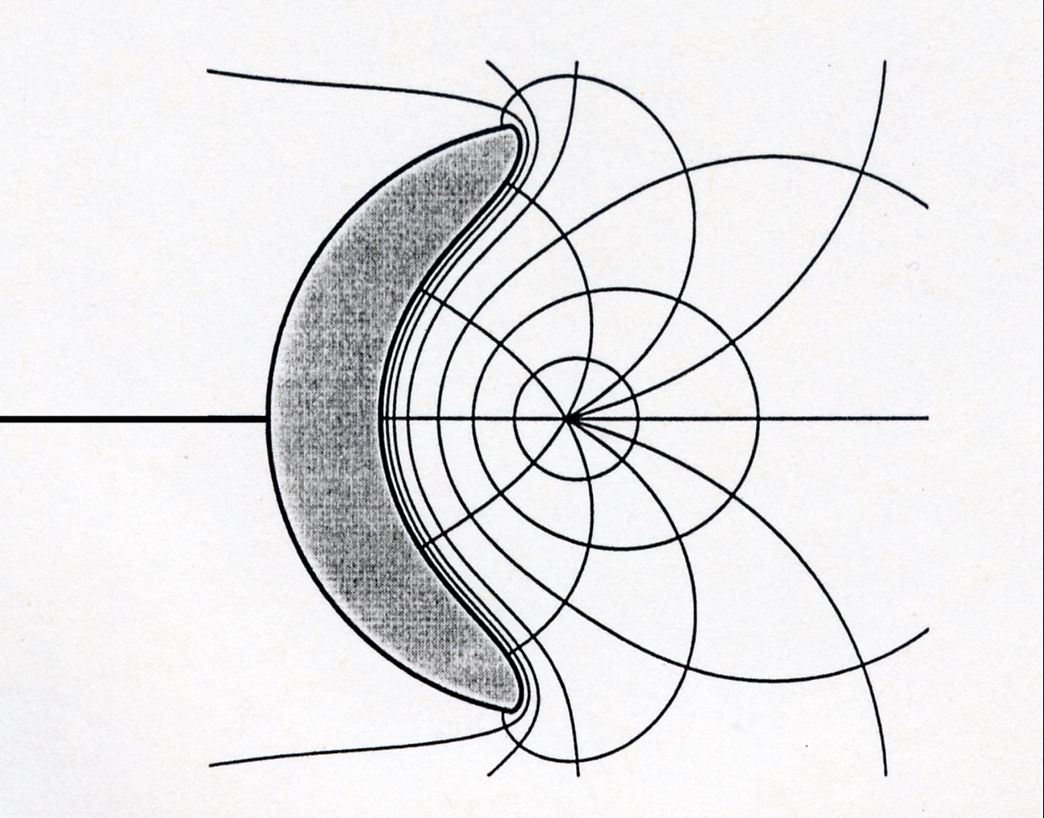
Omitted Area Problem
Barnard, Lewis

Slide 17
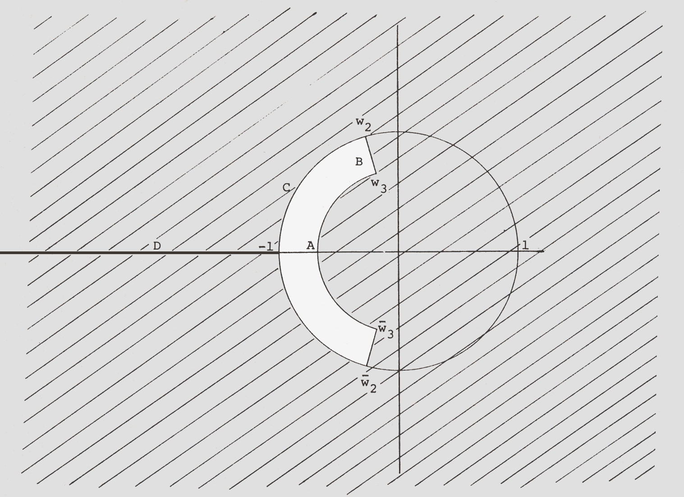
Omitted Area Problem
Gearlike Functions

Slide 18
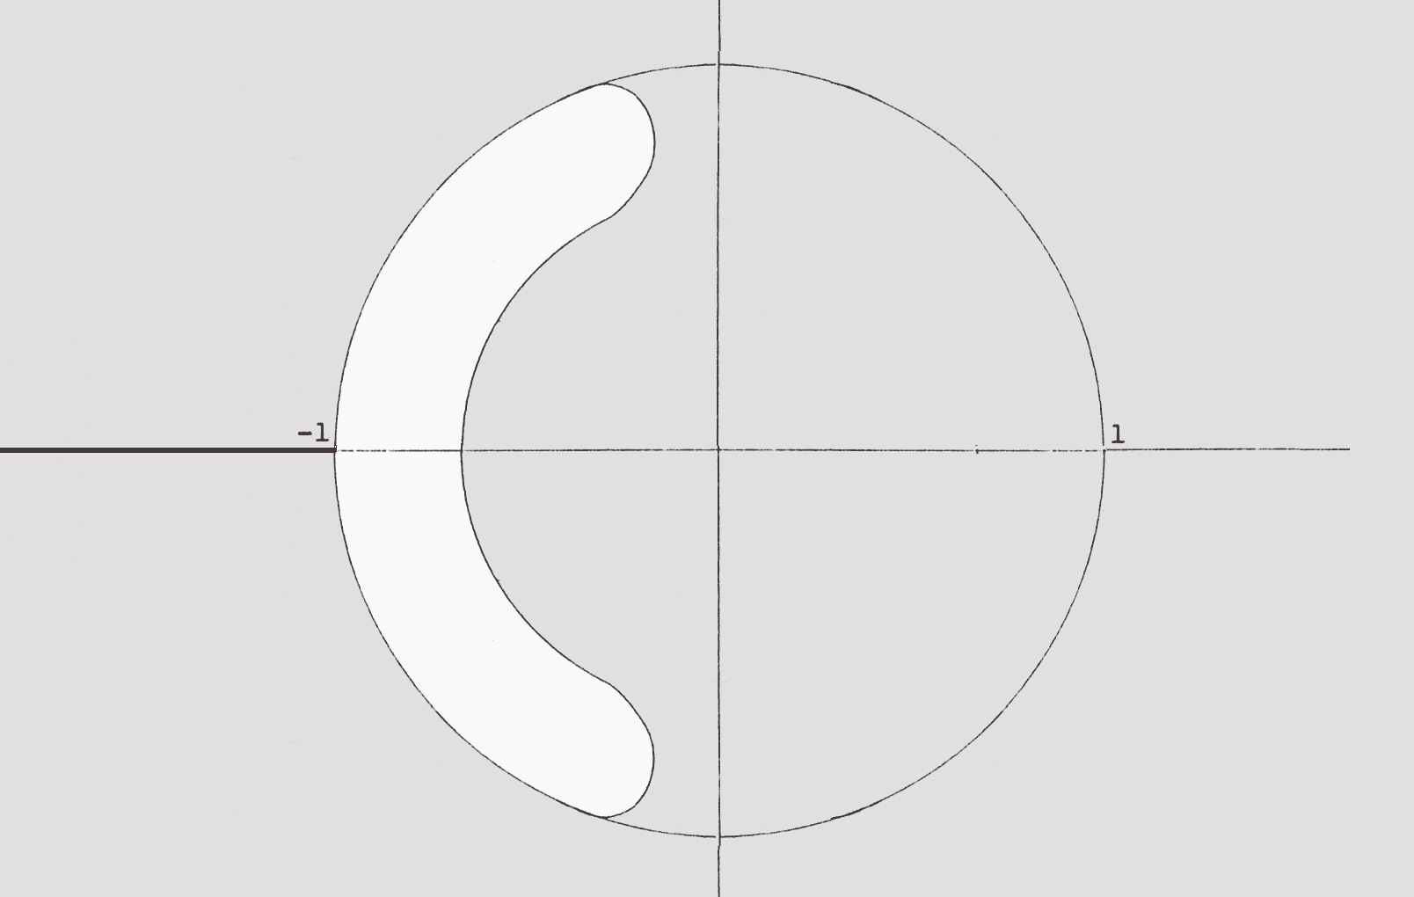
Omitted Area Problem
“Rounding” Corners

Slide 19
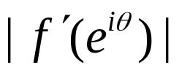
Omitted Area
Barnard, Pearce (1986)
A(f) ≈0.240005π
Banjai,Trefethn (2001)
  A. Optimation Problem: maximize A(f)
  B. Constraint Problem: constant
  A ≈0.2385813248π
Round off error
  A(f) ≈0.23824555π

Slide 20
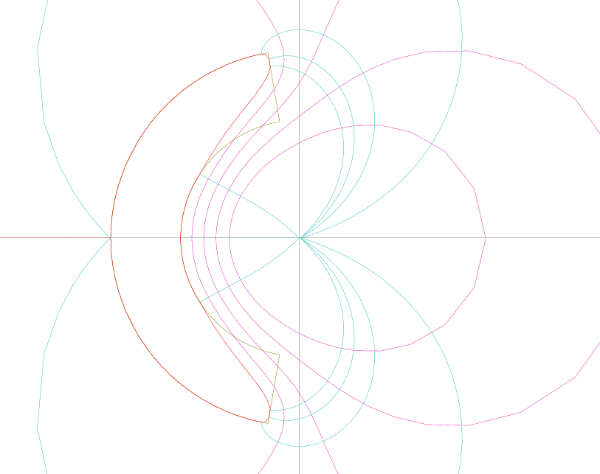
Omitted Area Problem

Slide 21
Polynomials with Nonnegative Coefficients
Can a conjugate pair of zeros be factored from a polynomial with nonnegative coefficients so that the resulting polynomial still has nonnegative roots?
Notes:
Applications to number theory and control theory

Slide 22
Polynomials with Nonnegative Coefficients
Initially, we supposed that if the pair of zeros with greatest real part were factored out, the result would hold
In fact, it is true for polynomials of degree less than 6
But,

Slide 23

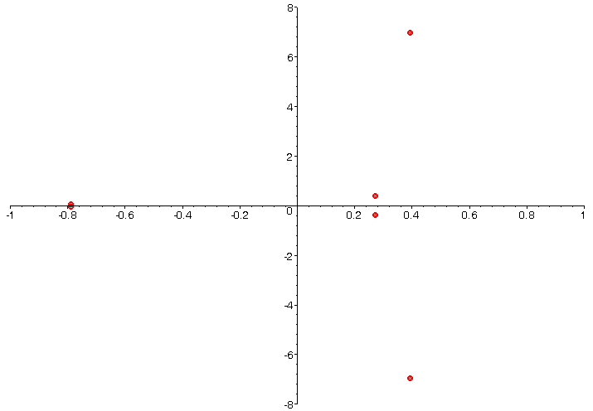
Polynomials with Nonnegative Coefficients

Slide 24
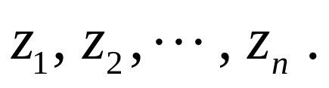
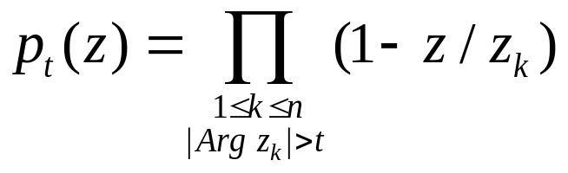
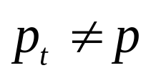

Polynomials with Nonnegative Coefficients
Theorem: Let p be a polynomial with nonnegative coefficients with p(0) = 1 and zeros
For t ≥ 0 write
Then, if , all of the coefficients of are positive.

Slide 25
Linearity/Monotonicity Arguments
Sturm Sequence Arguments
Coefficient Conjecture of Brannan
Bounds for Schwarzian Derivatives for Hyperbolically Convex Functions
Iceberg-type Problems in Two-Dimensions
Campbell’s Subordination Conjecture

Slide 26
(P)Lots of Dots

Slide 27
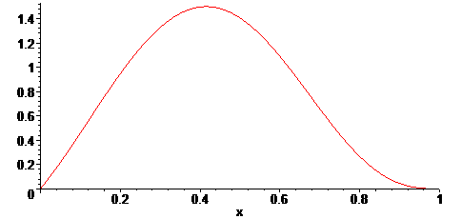
(P)Lots of Dots
Notes:
The displayed “graph” suggests that on the interval (0,1) that f > 0. The problem is that the display is misleading as to what exactly is being presented.

Slide 28
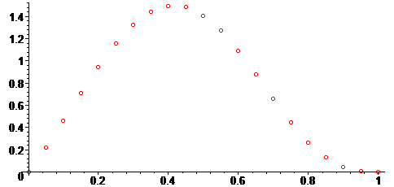
(P)Lots of Dots
Notes:
In reality, Maple or Mathematica or Silver Edition TI-84 is constructing a plot of dots (perhaps lots of them) and then connecting the dots linearly. Since the function is not linear or even piece-wise linear . . .

Slide 29
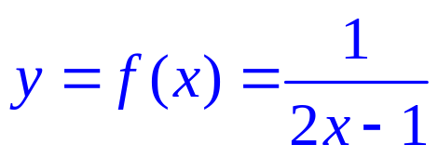
(P)Lots of Dots
Notes:
Rational function – singularity at x = 1/2. Graph consists of a pair of branches of a rectangular hyperbola.

Slide 30
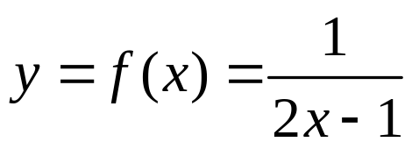
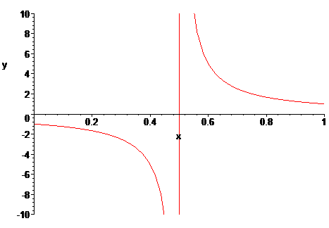
(P)Lots of Dots
Notes:
Maple is not drawing the asymptote. Maple is connecting the dots.

Slide 31
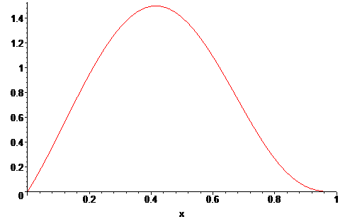
Blackbox Approximations
Polynomial

Slide 32

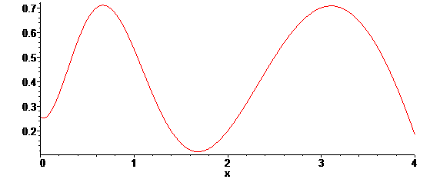
Blackbox Approximations
Transcendental / Special Functions

Slide 33
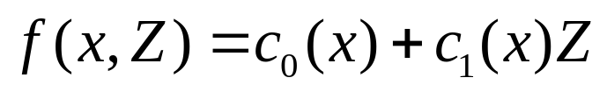

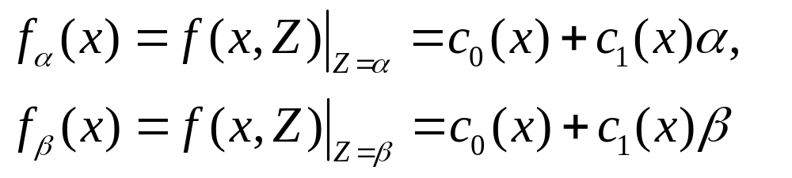
Linearity / Monotonicity
Consider
where
Let
Then,

Slide 34
Sturm Sequence
General theorem for counting the number of distinct roots of a polynomial f on an interval (a, b)
N. Jacobson, Basic Algebra. Vol. I., pp. 311-315,W. H. Freeman and Co., New York, 1974.
H. Weber, Lehrbuch der Algebra, Vol. I., pp. 301-313, Friedrich Vieweg und Sohn, Braunschweig, 1898

Slide 35
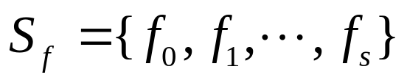

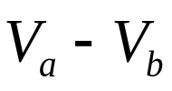

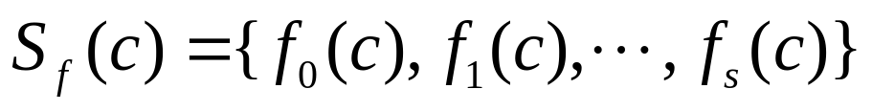
Sturm Sequence
Sturm’s Theorem. Let f be a non-constant polynomial with rational coefficients and let a < b be rational numbers. Let
be the standard sequence for f . Suppose that
Then, the number of distinct roots of f on (a, b) is where denotes the number of sign changes of

Slide 36

Sturm Sequence
Sturm’s Theorem (Generalization). Let f be a non-constant polynomial with rational coefficients and let a < b be rational numbers. Let
be the standard sequence for f . Then, the number of distinct roots of f on (a, b] is where denotes the number of sign changes of

Slide 37

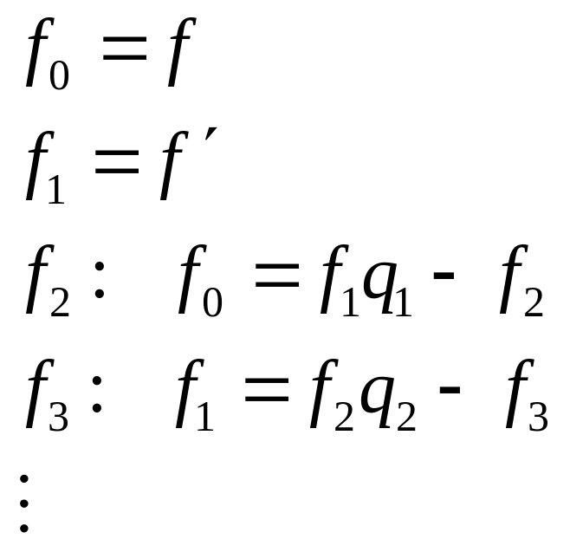
Sturm Sequence
For a given f, the standard sequence is constructed as:
Notes:
f _0= x^3 + 3x^2 + 6x -2
f_1 = 3x^2 + 6x + 6
f_2 = -2x + 4
f_3 = -1

Slide 38
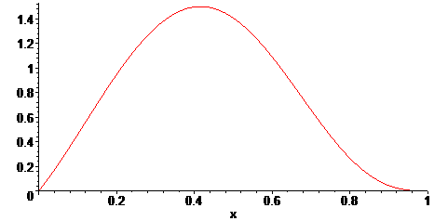
Sturm Sequence
Polynomial

Slide 39
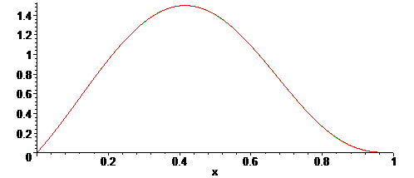
Sturm Sequence
Polynomial

Slide 40
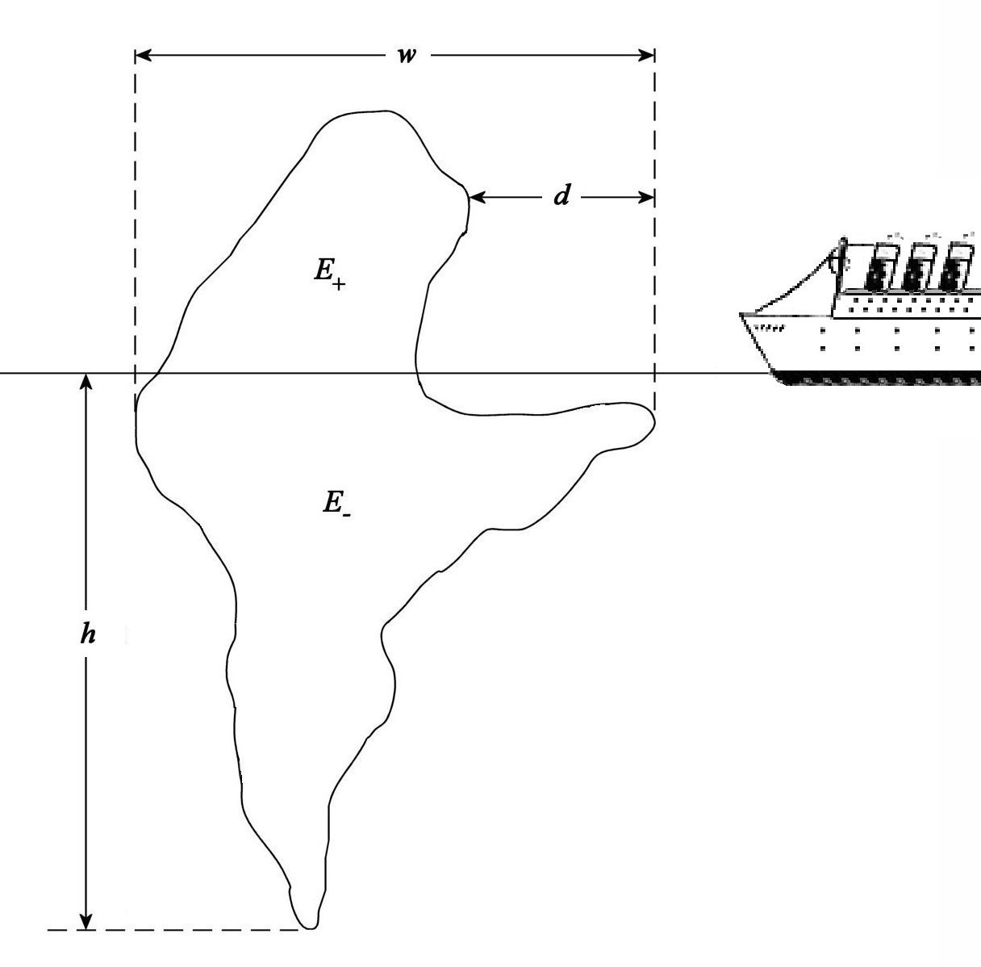
Iceberg-Type Problems

Slide 41
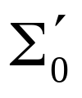

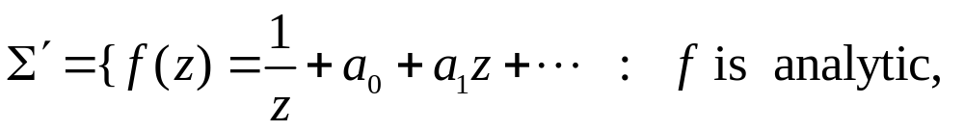


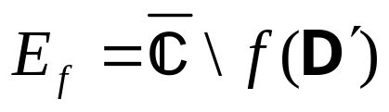
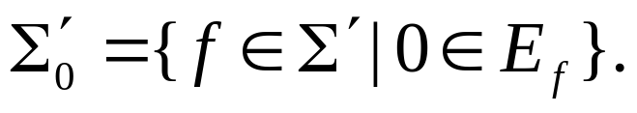
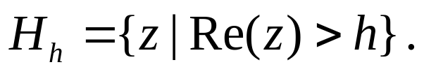
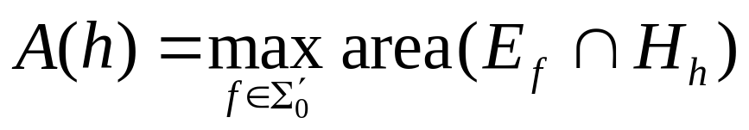
Iceberg-Type Problems
Dual Problem for Class
  Let and let
  For let
  and For 0 < h < 4, let
  Find

Slide 42
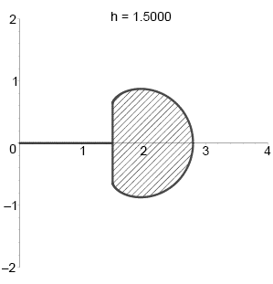
Iceberg-Type Problems
Extremal Configuration
  Symmetrization
  Polarization
  Variational Methods
  Boundary Conditions

Slide 43
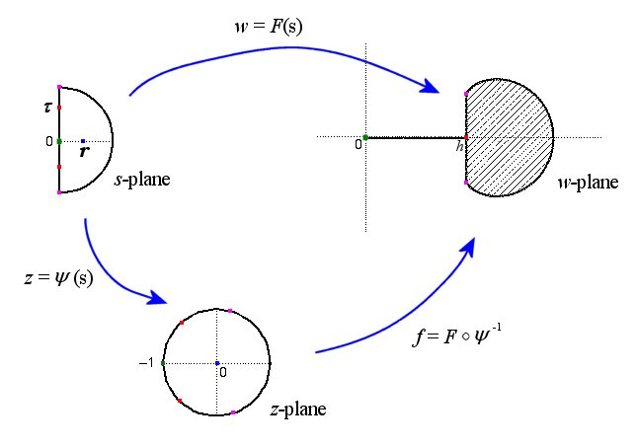
Iceberg-Type Problems

Slide 44
Iceberg-Type Problems
We obtained explicit formulas for A = A(r)
and h = h(r). However, the orginial problem was formulated to find A as a function of h, i.e. to find A = A(h).
To find an explicit formulation giving A = A(h), we needed to verify that h = h(r) was monotone.

Slide 45
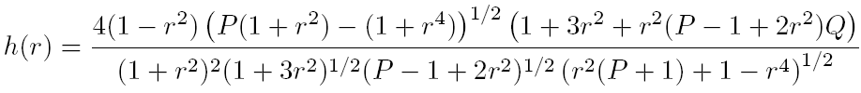

Iceberg-Type Problems
From the construction we explicitly found
where

Slide 46
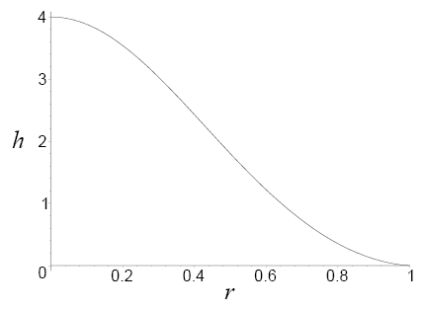
Iceberg-Type Problems

Slide 47

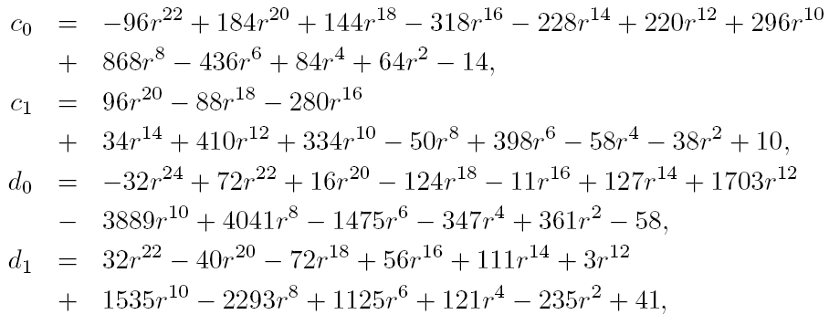
Iceberg-Type Problems
where

Slide 48
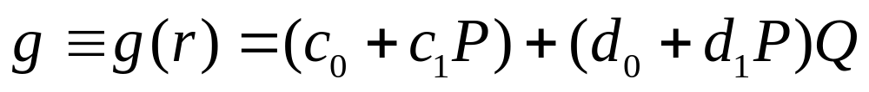
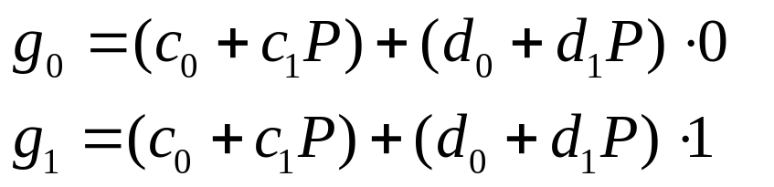
Iceberg-Type Problems
It remained to show
was non-negative. In a separate lemma, we showed 0 < Q < 1. Hence, using the linearity of
Q in g, we needed to show
were non-negative

Slide 49
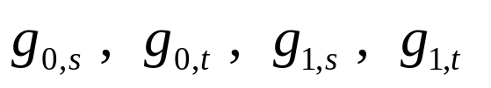
Iceberg-Type Problems
In a second lemma, we showed s < P < t where
Let
Each is a polynomial with rational coefficients for which a Sturm sequence argument show that it is non-negative.

Slide 50
Conclusions
There are “proof by picture” hazards
  CAS numerical computations are rational number calculations
  CAS “special function” numerical calculations are inherently finite approximations
There is a role for CAS in analysis
There are various useful, practical strategies for rigorously establishing analytic inequalities

